Slide 1
Normal Distribution

Slide 2
Normal Distribution
Called a Probability density function. The probability is interpreted as "area under the curve."
1) The random variable takes on an infinite # of values within a given interval
2) the probability that X = any particular value is 0. Consequently, we talk about intervals. The probability is = to the area under the curve.
3) The area under the whole curve = 1.

Slide 3
Normal Distribution
Probabilities are obtained by getting the area under the curve inside of a particular interval. The area under the curve = the proportion of times under identical (repeated) conditions that a particular range of values will occur.
3 Characteristics of the Normal distribution:
It is symmetric about the mean μ.
Mean = median = mode. [“bell-shaped” curve]
f(X) decreases as X gets farther and farther away from the mean. It approaches horizontal axis asymptotically: - ∞ < X < + ∞. This means that there is always some probability (area) for extreme values.

Slide 4
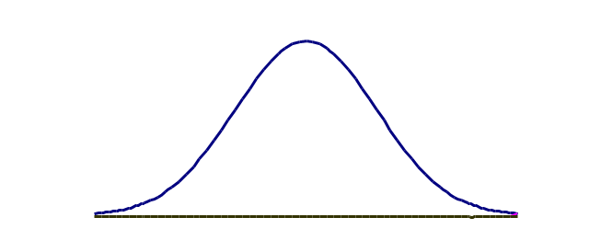

Normal Distribution
The probability density function for the normal distribution:
$f\left(X\right)= \frac{1}{σ\sqrt{2π}}e^{−\frac{1}{2}{\left(\frac{X−μ}{σ}\right)}^{2}}$
X
f(X) the height of the curve, represents the relative frequency at which the corresponding values occur.

Slide 5
Normal Distribution
Note that the normal distribution is defined by two parameters, μ and σ . You can draw a normal distribution for any μ and σ combination. There is one normal distribution, Z, that is special. It has a μ = 0 and a σ = 1. This is the Z distribution, also called the standard normal distribution. It is one of trillions of normal distributions we could have selected.

Slide 6
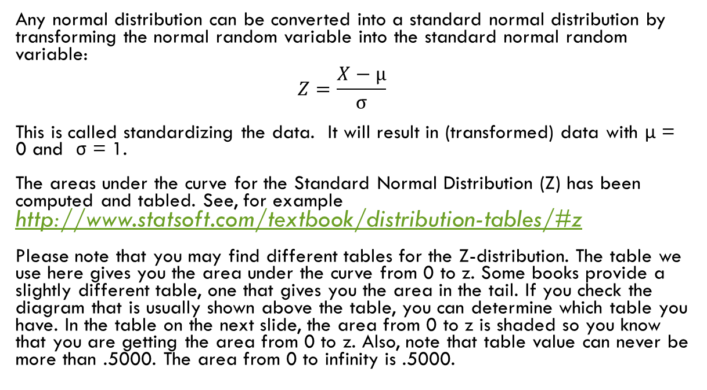
Z-Distribution
Any normal distribution can be converted into a standard normal distribution by transforming the normal random variable into the standard normal random variable:
$$Z=\frac{X−μ}{σ}$$
This is called standardizing the data. It will result in (transformed) data with μ = 0 and σ = 1.
The areas under the curve for the Standard Normal Distribution (Z) has been computed and tabled. See, for example http://www.statsoft.com/textbook/distribution-tables/#z
Please note that you may find different tables for the Z-distribution. The table we use here gives you the area under the curve from 0 to z. Some books provide a slightly different table, one that gives you the area in the tail. If you check the diagram that is usually shown above the table, you can determine which table you have. In the table on the next slide, the area from 0 to z is shaded so you know that you are getting the area from 0 to z. Also, note that table value can never be more than .5000. The area from 0 to infinity is .5000.

